Slide 1
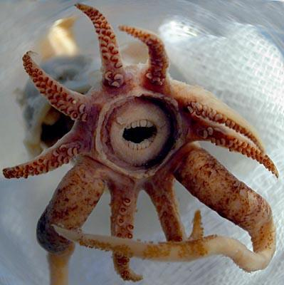
Mollusks
Kingdom Animalia Phylum Mollusca (means “soft”)
(Ch 27.4)

Slide 2
What is a Mollusk?
Soft body with internal or external shell
Ex: snails, slugs (shell less), clams, squids, and octopi
Trochophore Larva
Body plan:
Foot – takes on many forms
Mantle – covers the body
Shell – (present in most)
Visceral mass – internal organs

Slide 3
Groups of Mollusks
Classified according to their foot and shell
Three major classes of mollusks
Gastropods
Bivalves
Cephalopods

Slide 4
Gastropod
snails, slugs, limpets and nudibranchs
Shell-less or single shelled
Move by a muscular foot
Some are poisonous, bright colors

Slide 5
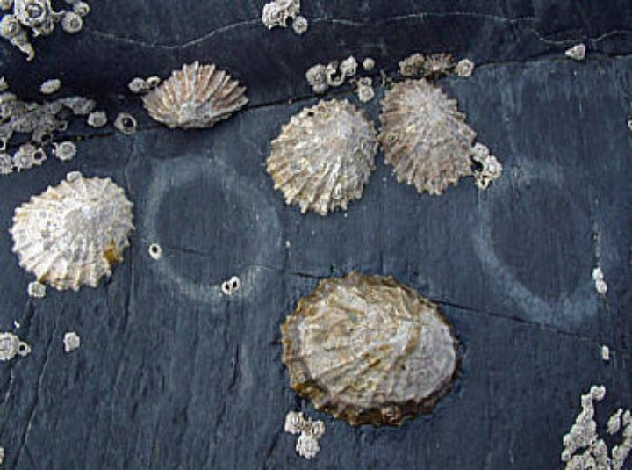
Limpet

Slide 6
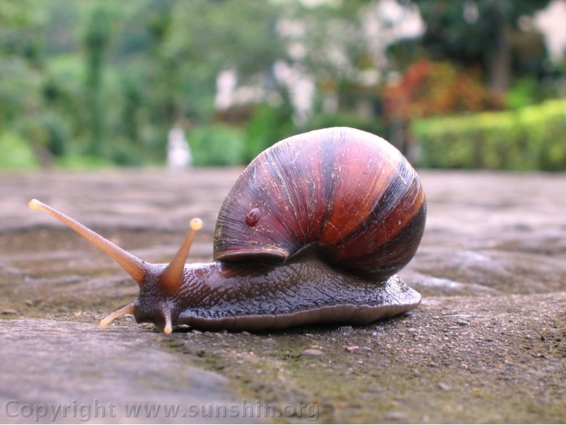
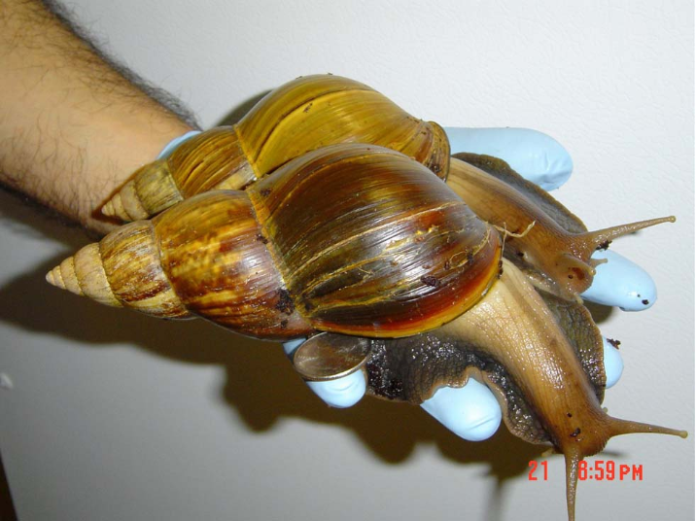
Snail

Slide 7
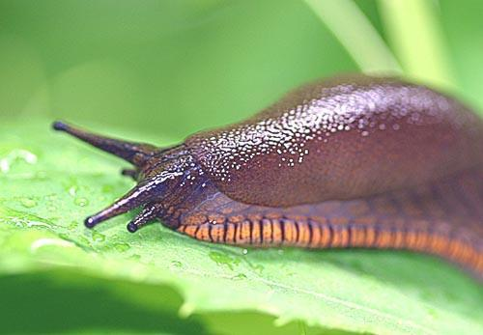
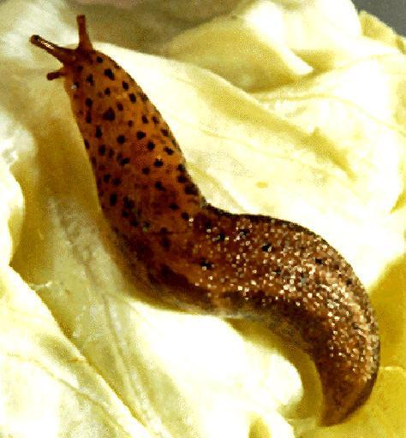
Slug

Slide 8
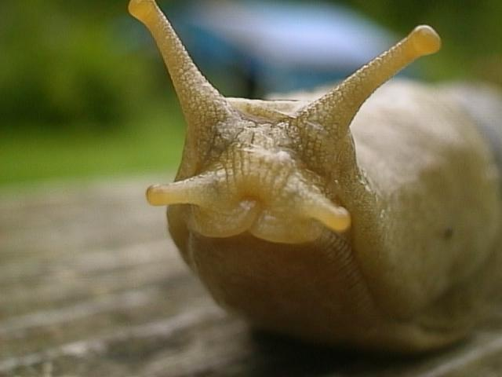

Slide 9
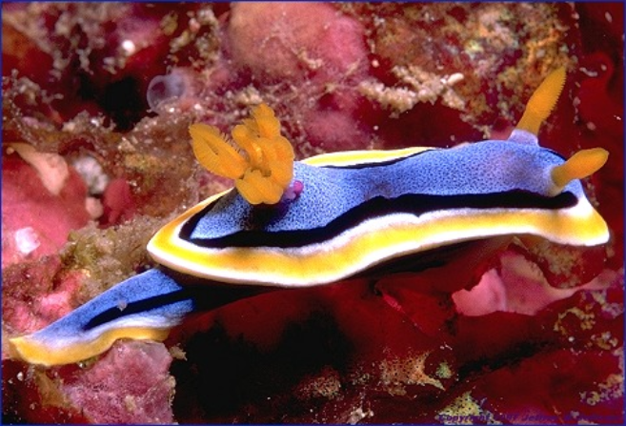
Nudibranchs (sea slugs)
http://ngm.nationalgeographic.com/2008/06/nudibranchs/doubilet-photography

Slide 10
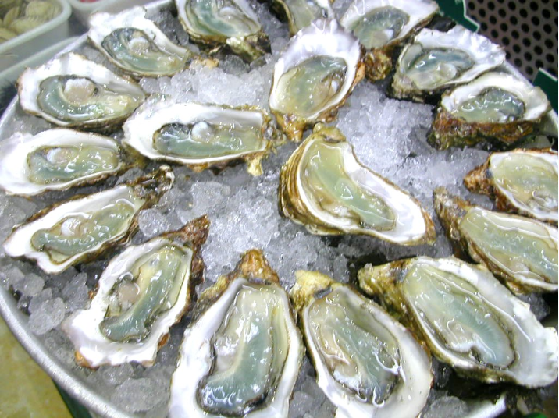
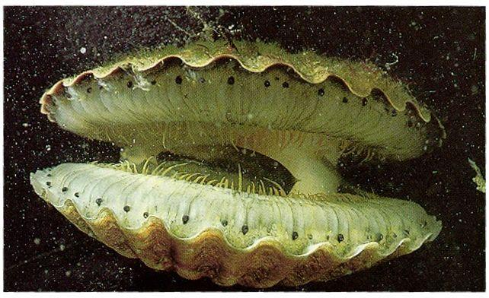
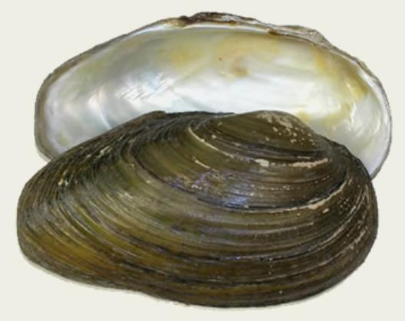
Bivalves (things with 2 shells)
Such as clams, scallops

Slide 11
Cephalopods
octopi, squids, cuttlefish, and nautilus
soft-bodied , head is attached to foot
foot is divided into tentacles with sucking disks
small internal shells or no shell at all
Nautilus is only present day cephalopod with shell (figure 27-27)
Squid have a modified shell called a pen
Well developed eyes
most complex of the mollusks

Slide 12
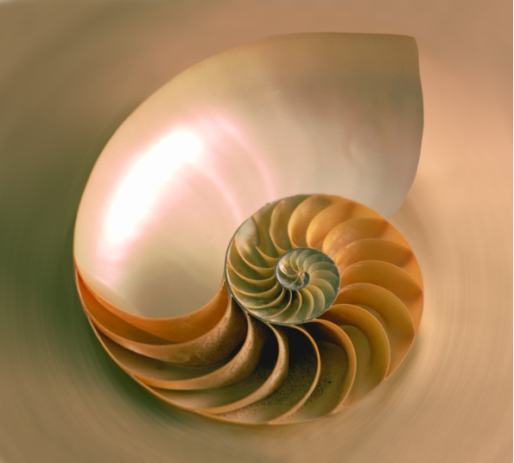
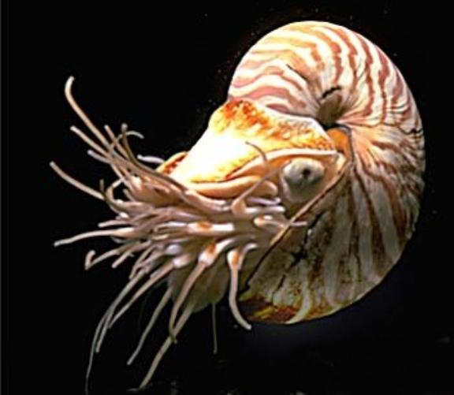
Nautilus(only cephalopod with a shell)

Slide 13
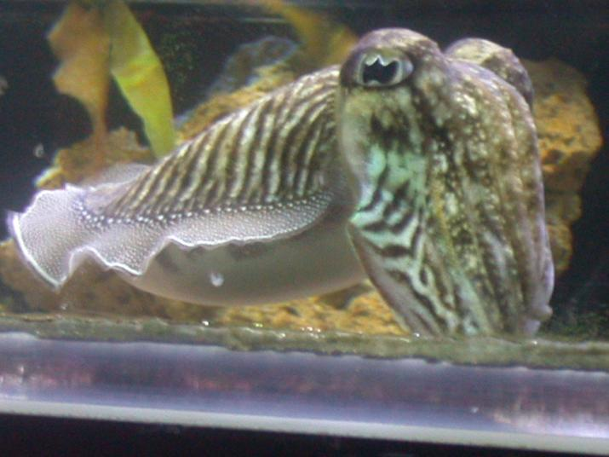
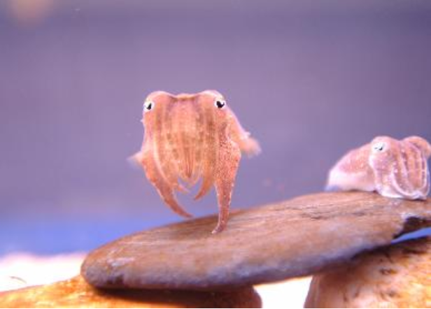
Cuttlefish (can change colors)

Slide 14
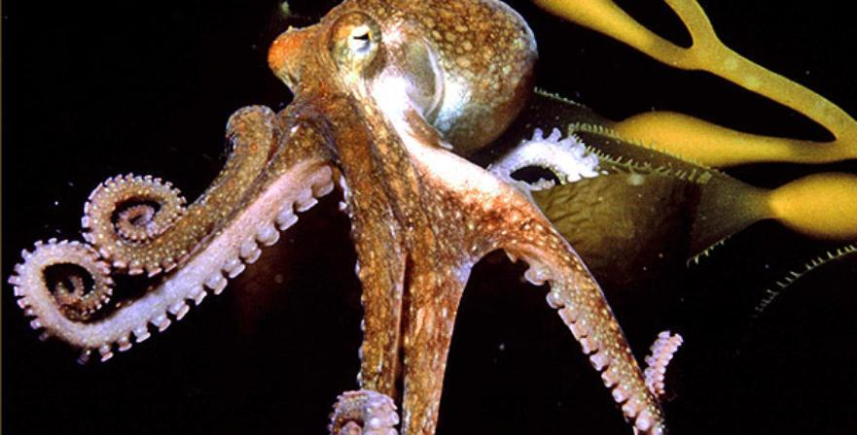
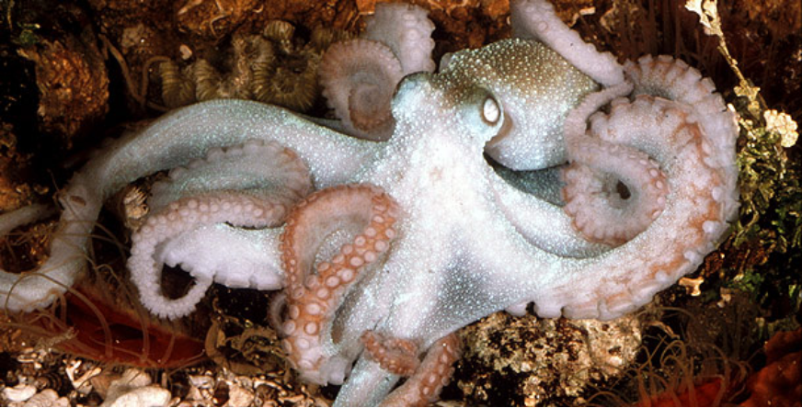
Octopus (creeps on tentacles)

Slide 15
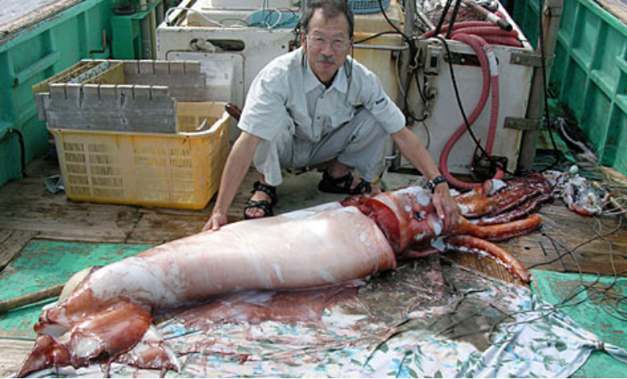
Squid

Slide 16
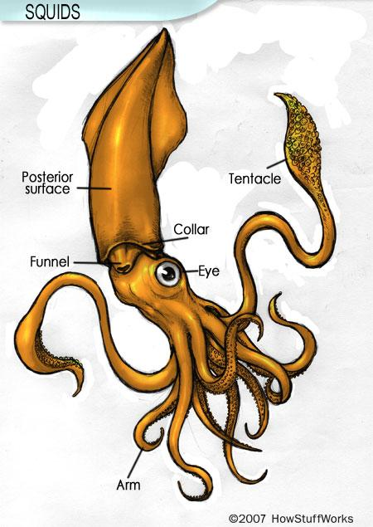
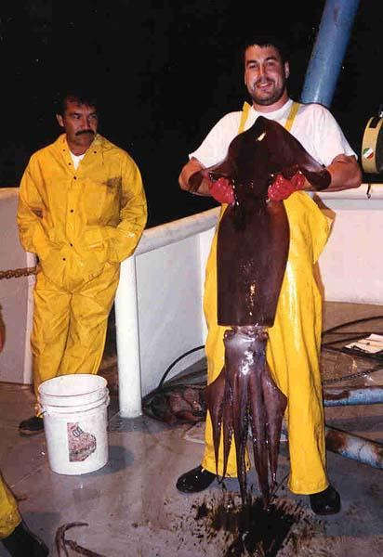
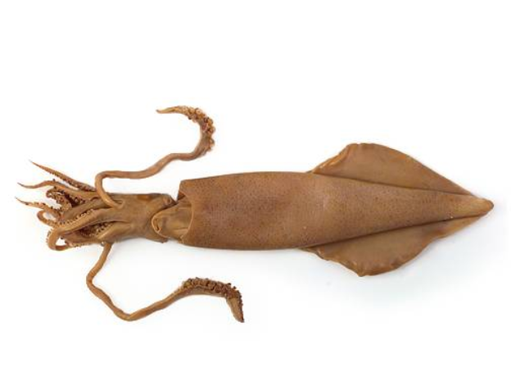

Slide 17
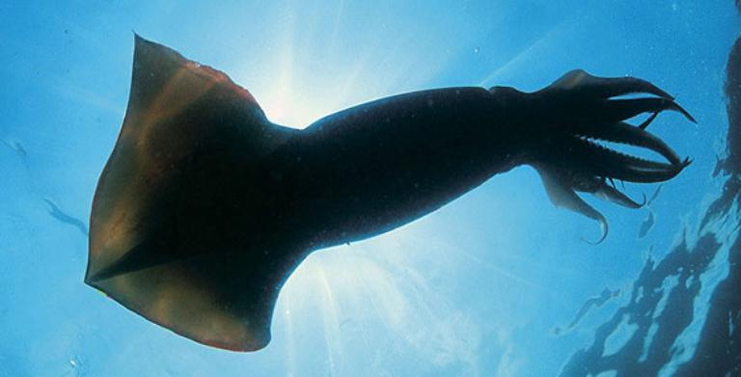
Do Giant Squids and Octopus Exist?
See Videos at National Geographic

