Slide 1
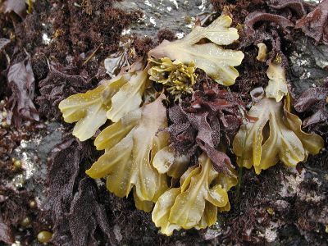
Marine Science:
Marine Algae, Sea-grasses and Emergent Plants

Slide 2
Producers in the Marine Environment
Algae, sea-grasses and emergent plants constitute common marine plants.
All live in photic zones because all perform photosynthesis.
Photosynthesis occurs through the following reaction:
6CO₂ + 6H₂O→ C₆H₁₂O₆ + 6O₂
Algae live in the Neritic Province (above the Continental Shelf), and the Epipelagic Zone of the Oceanic Province.
Sea-grasses are rooted to the seafloor and must live in the Neritic Province in order to have adequate light.
Emergent plants live in the littoral zone.

Slide 3
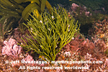
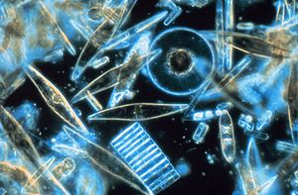
Marine Algae
Macroscopic marine algae were once classified among the protists, but have now been moved back to the plant kingdom.
Microscopic algae, such as diatoms, are still categorized with the protists.
Macroscopic algae are non-vascular plants, which means that they lack vascular tissue and have no true roots, stems and leaves.
The macroscopic algae are divided into three phyla.

Slide 4
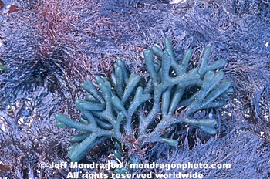
Phylum Chlorophyta
Phylum Chlorophyta includes the green algae (e.g. Ulva, or sea lettuce).
These plants have chlorophyll and other pigments similar to vascular plants.
There are many freshwater species in addition to the species found in the marine environment.

Slide 5
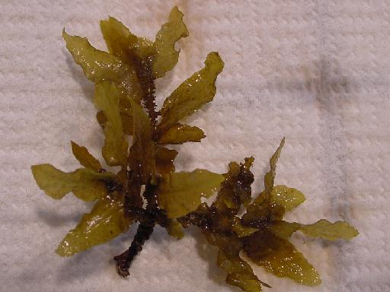
Phylum Phaeophyta
Phylum Phaeophyta includes the brown algae (e.g. kelp).
Brown algae have the pigment fucoxanthin, in addition to chlorophyll.
These algae are almost entirely marine species.
They are the largest algae—some are longer than 100 ft.
Brown algae tend to grow in colder ocean waters (with the exception of Sargassum, which is common in the Gulf Stream).

Slide 6
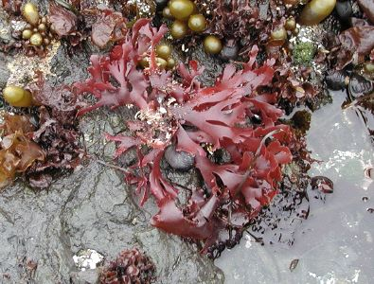
Phylum Rhodophyta
Phylum Rhodophyta includes the red algae (e.g. Irish moss).
Like brown algae, most red algae are found in the marine environment.
Red algae contain the pigment phycoerythrin in addition to chlorophyll.
Because of their accessory pigments, red algae can collect light in both the photic and disphotic zone, and are found in deeper areas than other algae.

Slide 7
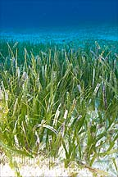
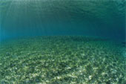
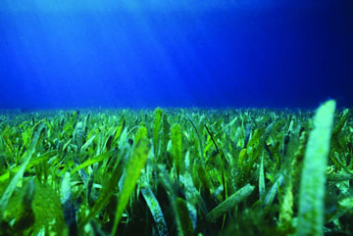
Sea-grasses
Sea-grasses are vascular plants that have adapted to life underwater. They are totally submergent (meaning that no part of them rises above the water’s surface).
Sea-grasses are angiosperms (flowering plants), related to the grasses we have on land.
There are three common varieties of sea-grass in Florida:
Turtle grass (Thalassia testudium)
Shoal grass (Halodule wrightii)
Manatee grass (Syringodium filiforme)

Slide 8
Functions of Sea-grasses
Sea-grasses are useful in a number of ways:
They provide oxygen for gilled animals in the water.
They provide food and are the base of many food chains.
They assist in maintaining water clarity by trapping sediments.
They reduce erosion and stabilize soft sediments.
They provide shelter for smaller animals and hence, are often considered the nursery grounds of the sea.

Slide 9
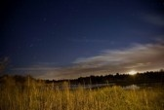
Emergent Plants
Emergent plants are vascular plants that are rooted in the bottom, below the water’s surface, but whose stems and leaves emerge from the water.
These plants are salt-tolerant and help stabilize shorelines.
Examples include mangrove trees (red, black and white), salt marsh cord grass (Spartina), rushes (Juncus), and salt grass (Distichlis)

Slide 10
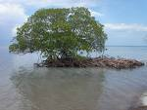
Mangroves
Mangroves are simply salt-tolerant trees. In the U.S. there are three types:
Red mangrove (Rhizophora mangle)—the most seaward growing of the mangroves; not cold tolerant; has characteristic prop roots to stabilize it; forms mangrove islands; is a salt excluder (eliminates salt at the root).
Black mangrove (Avicennia germinans)—most cold tolerant; upper littoral; has pneumatophores (“snorkel roots”)for gas exchange; salt excreter (leaves excrete salt from glands on underside).
White mangrove (Laguncularia racemosa)—grows inland from red and black mangroves; not cold tolerant; important for erosion protection; has nectar glands at the base of each leaf.

