Slide 1
Phylum Mollusca
review

Slide 2
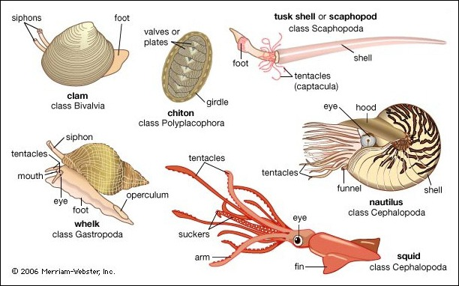
What are some Examples of organisms in phylum Mollusca?
Snails, octopuses, squids and oysters are examples of molluscs.

Slide 3
What does the word Mollusc mean?
The word “mollusc” means “soft thing”. Molluscs have soft bodies

Slide 4
What are the Major classes phylum Mollusca?
Bivalvia, Gastropoda, Cephalopoda

Slide 5
What is the type of digestive system in molluscs?
Molluscs present extracellular digestion and a complete digestive system, with mouth and anus.

Slide 6
What organ system is present in Mollusca that has not been present before?
A defined Circulatory System

Slide 7
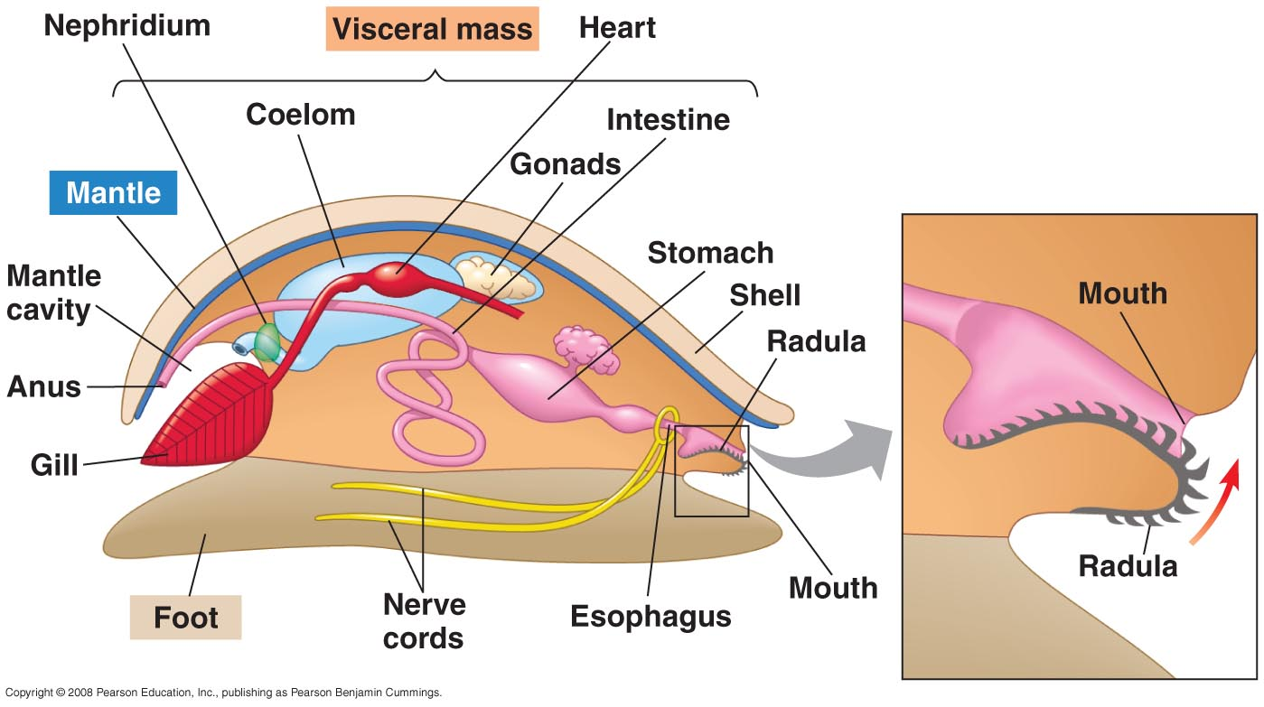
Main body structure of Phylum Mollusca

Slide 8
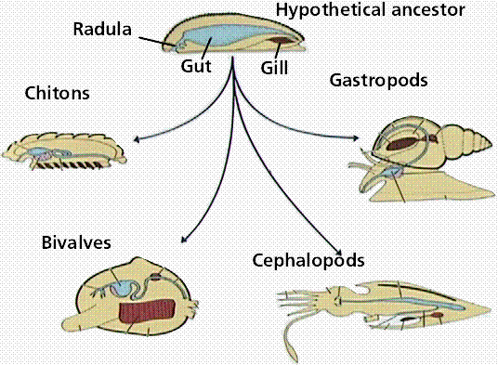
Class Body Structures

